Slide 1
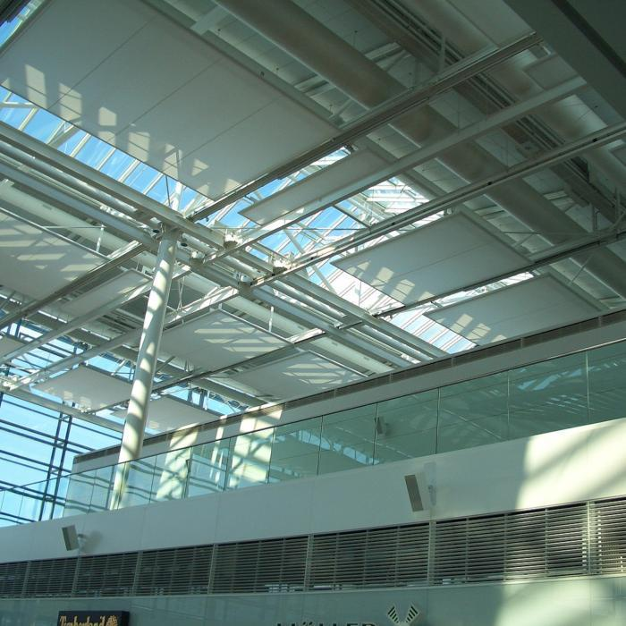
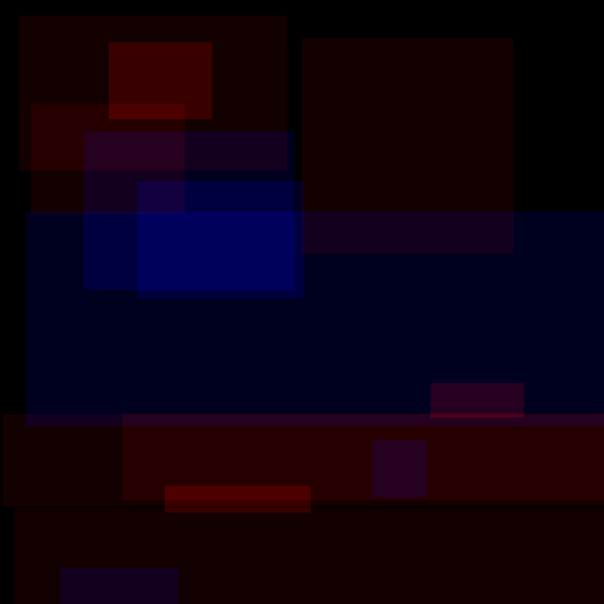
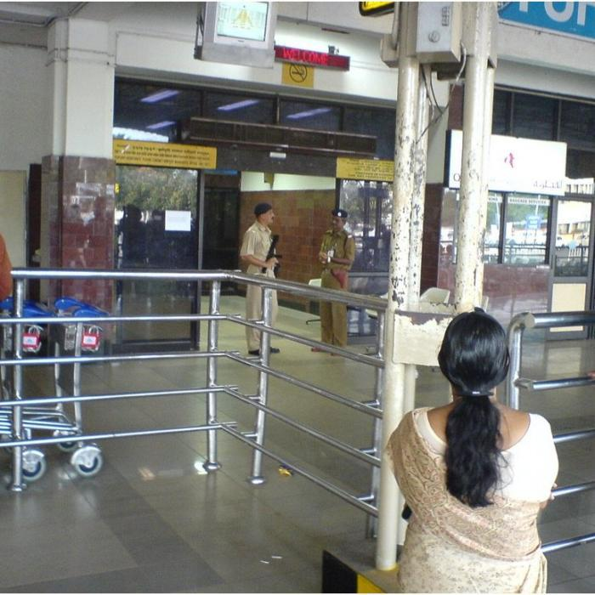
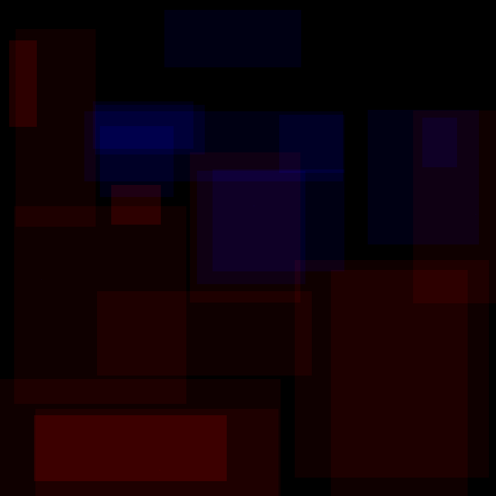
Model (based on):
Clutter
Symmetry
Openness
Entropy
Red -> simple
Blue-> complex
Scenic Images
Human Labelled Ground Truths

Slide 2
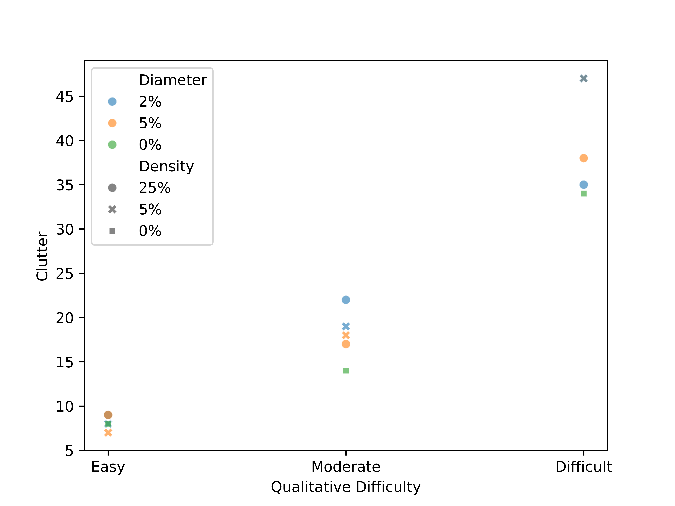

Slide 3
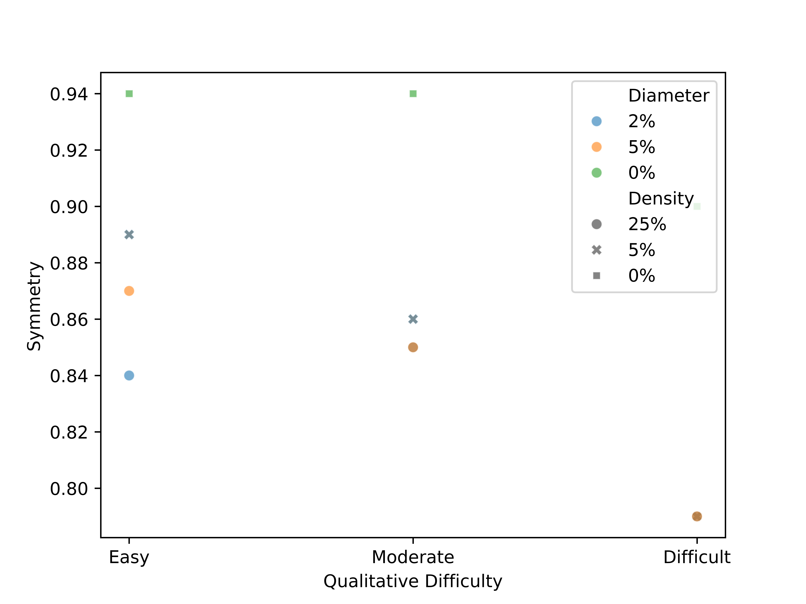

Slide 4
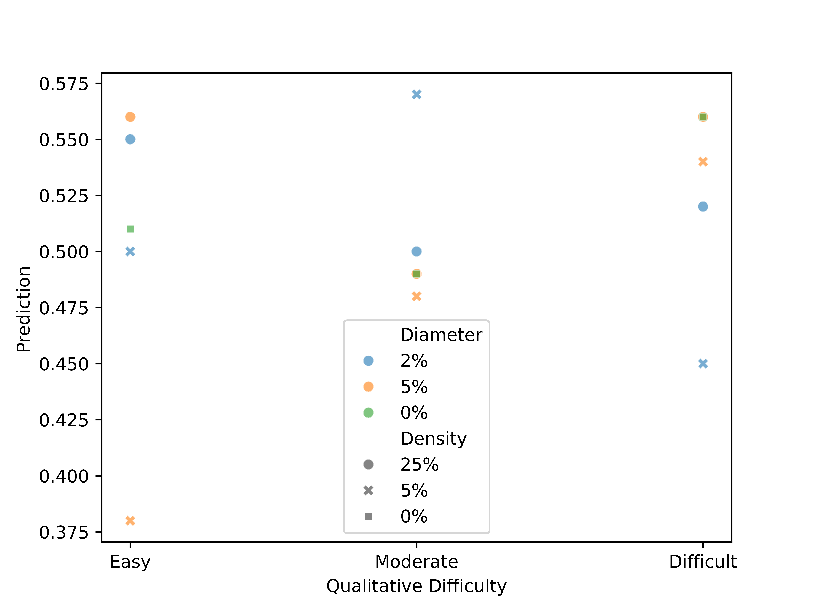

Slide 5
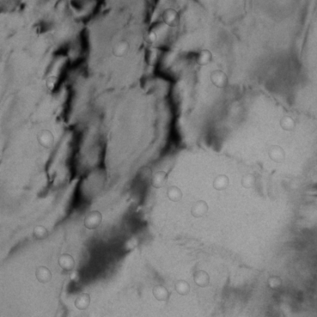

Image: Image_0-3ATYY4.png
Symmetry: 0.86
Clutter: 18
Prediction: 0.48

Slide 6


Image: Image_0-6JNS7M.png
Symmetry: 0.86
Clutter: 19
Prediction: 0.57

Slide 7
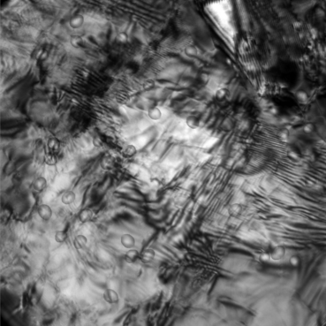

Image: Image_0-6NBE7Z.png
Symmetry: 0.79
Clutter: 47
Prediction: 0.54

Slide 8


Image: Image_0-CBTJTK.png
Symmetry: 0.79
Clutter: 47
Prediction: 0.45

Slide 9
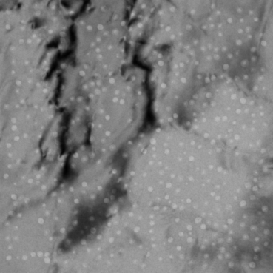

Image: Image_0-EIT0RD.png
Symmetry: 0.85
Clutter: 22
Prediction: 0.5

Slide 10
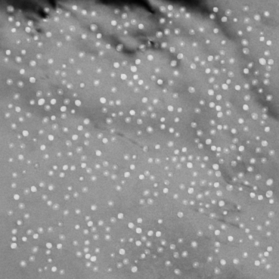

Image: Image_0-P2Z3RZ.png
Symmetry: 0.84
Clutter: 9
Prediction: 0.55

Slide 11
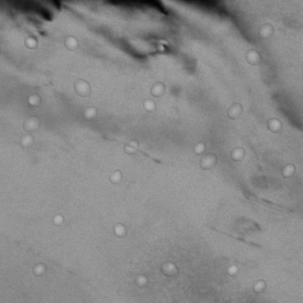

Image: Image_0-P5E5IT.png
Symmetry: 0.89
Clutter: 7
Prediction: 0.38

Slide 12
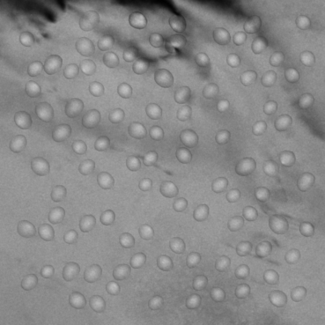

Image: Image_0-P9UB1H.png
Symmetry: 0.87
Clutter: 9
Prediction: 0.56

Slide 13
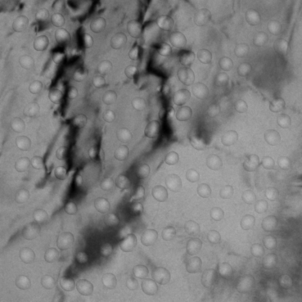

Image: Image_0-Q020H5.png
Symmetry: 0.85
Clutter: 17
Prediction: 0.49

Slide 14


Image: Image_0-QI7FRK.png
Symmetry: 0.79
Clutter: 35
Prediction: 0.52

Slide 15
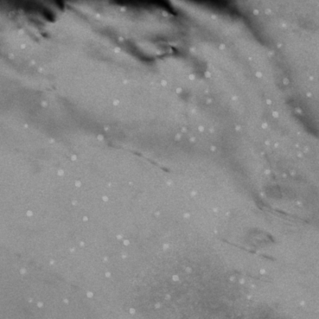

Image: Image_0-UKVR3B.png
Symmetry: 0.89
Clutter: 8
Prediction: 0.5

Slide 16


Image: Image_0-Z58QNY.png
Symmetry: 0.79
Clutter: 38
Prediction: 0.56

Slide 17


Image: 11 78K_2.png
Symmetry: 0.94
Clutter: 8
Prediction: 0.51

Slide 18


Image: 11 39K.png
Symmetry: 0.94
Clutter: 14
Prediction: 0.49

Slide 19


Image: 1 TEM-BF 94K defocus 0 um.png
Symmetry: 0.9
Clutter: 34
Prediction: 0.56

Slide 20
Image | Diameter | Density | Qualitative Difficulty | Symmetry | Clutter | Prediction
0-3ATYY4 | 5% | 5% | Moderate | 0.86 | 18 | 0.48
0-6JNS7M | 2% | 5% | Moderate | 0.86 | 19 | 0.57
0-6NBE7Z | 5% | 5% | Difficult | 0.79 | 47 | 0.54
0-CBTJTK | 2% | 5% | Difficult | 0.79 | 47 | 0.45
0-EIT0RD | 2% | 25% | Moderate | 0.85 | 22 | 0.5
0-P2Z3RZ | 2% | 25% | Easy | 0.84 | 9 | 0.55
0-P5E5IT | 5% | 5% | Easy | 0.89 | 7 | 0.38
0-P9UB1H | 5% | 25% | Easy | 0.87 | 9 | 0.56
0-Q020H5 | 5% | 25% | Moderate | 0.85 | 17 | 0.49
0-QI7FRK | 2% | 25% | Difficult | 0.79 | 35 | 0.52
0-UKVR3B | 2% | 5% | Easy | 0.89 | 8 | 0.5
0-Z58QNY | 5% | 25% | Difficult | 0.79 | 38 | 0.56
_2 | 0% | 0% | Easy | 0.94 | 8 | 0.51
 | 0% | 0% | Moderate | 0.94 | 14 | 0.49
BF 94K defocus 0 um | 0% | 0% | Difficult | 0.9 | 34 | 0.56

